Slide 1

Educational Trends Across Europe

Slide 2

Introduction
Purpose of Analysis
Dataset Used

Slide 3
Key Questions Addressed
How have overall government expenditure trends evolved from 2001 to 2017?
What are the patterns in teacher salaries across primary, upper secondary, and pre-primary education levels?
How do enrolment rates vary across different education levels, and what insights can be derived from these variations?
Gender Distribution of Teachers in primary and tertiary education across Europe.

Slide 4
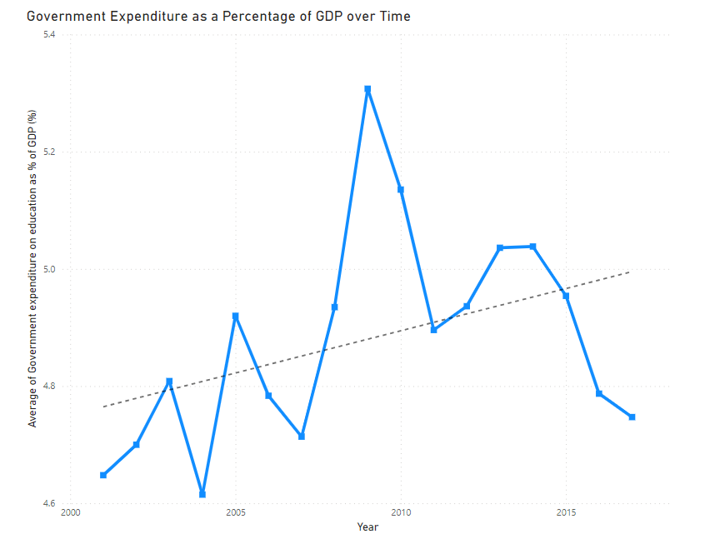
Overall Government Expenditure (2001-2017)

Slide 5
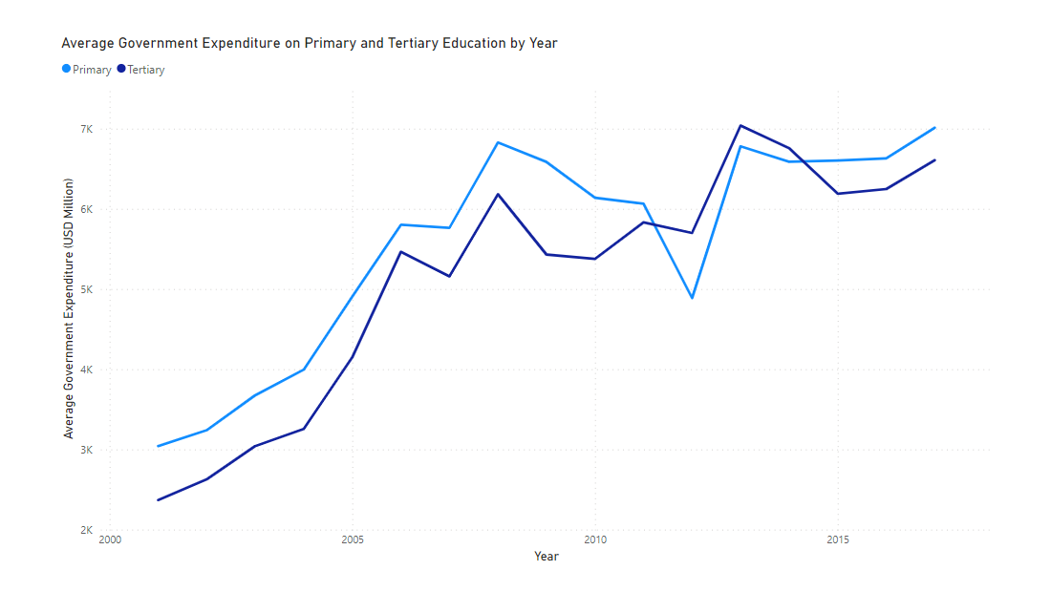
Primary and Tertiary

Slide 6
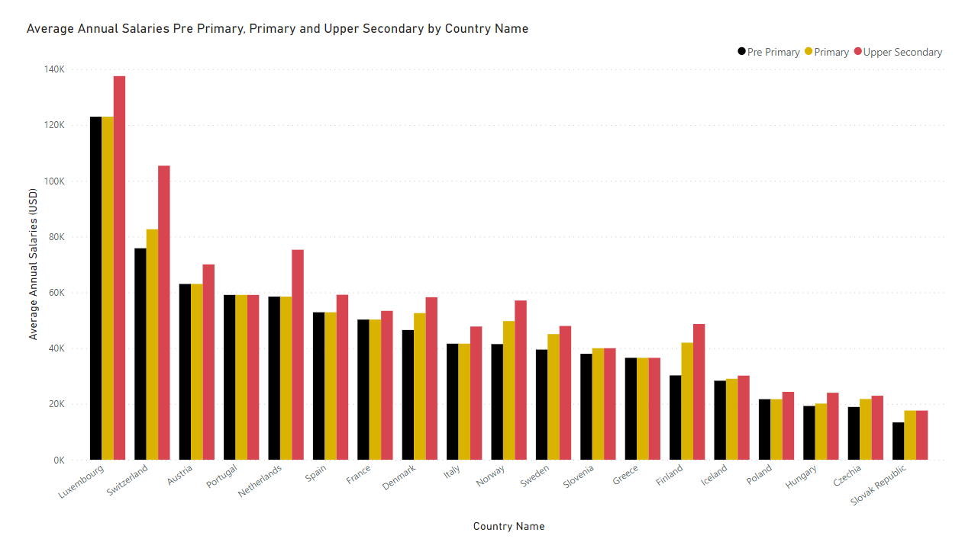
Teaching Staff Salary Analysis

Slide 7
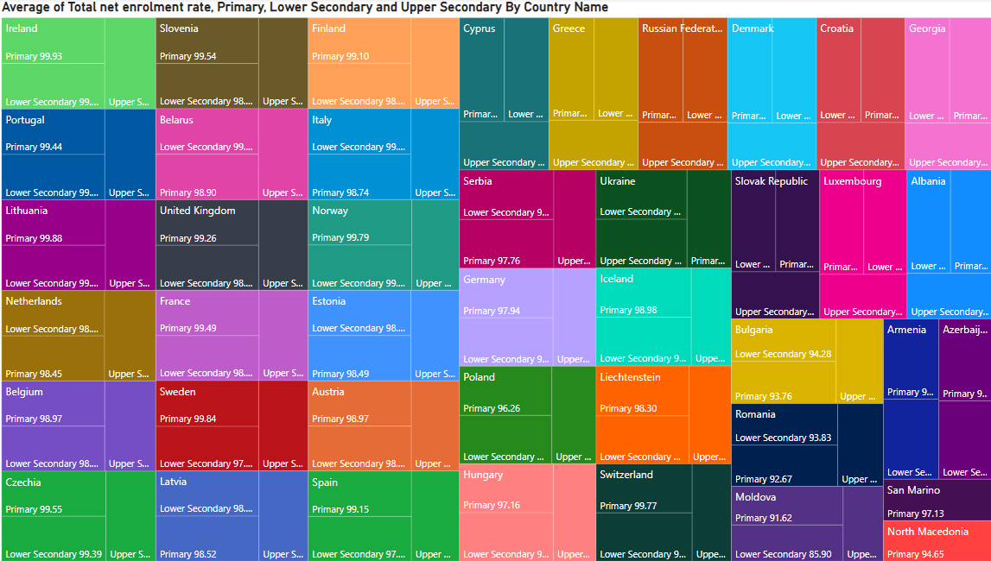
Enrollment Rates Overview

Slide 8
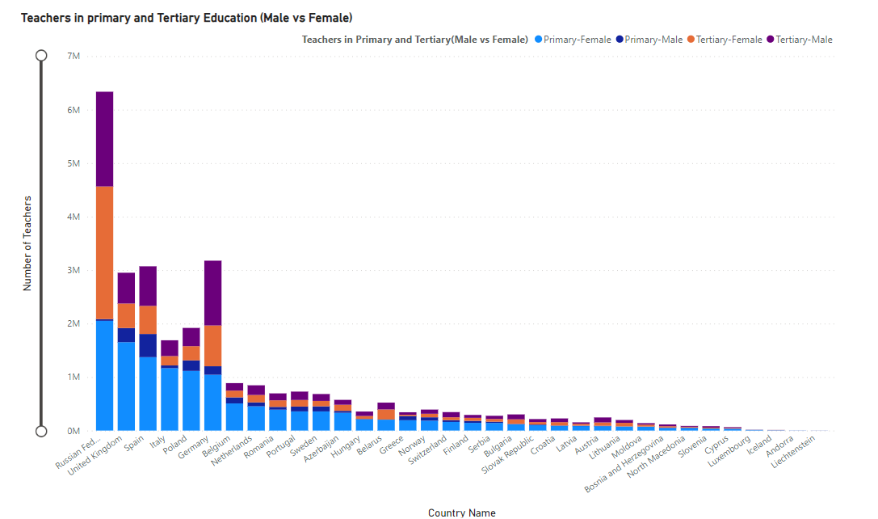
Gender Distribution of Teachers

Slide 9
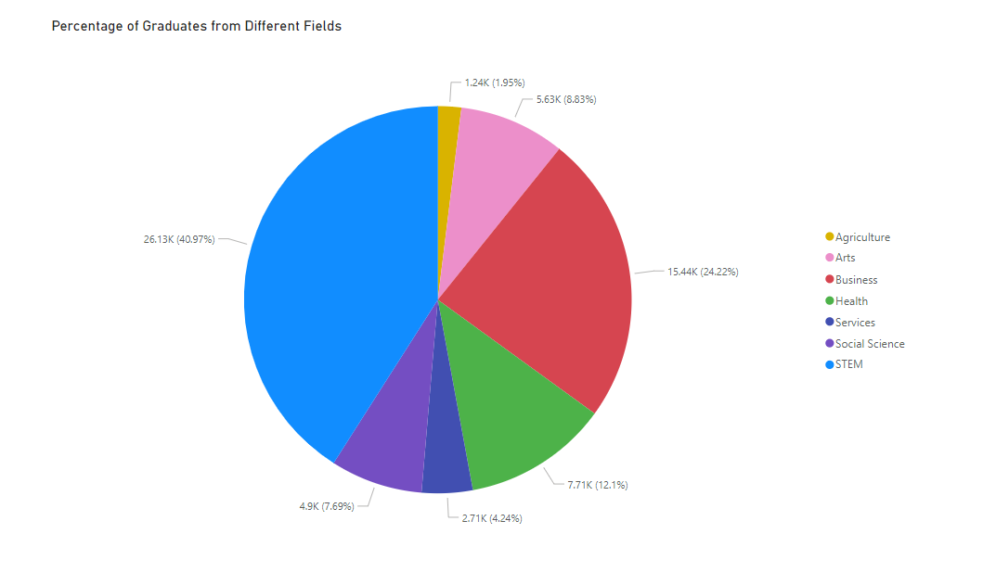
Graduates From Different Fields

Slide 10

Thank YOU

